Slide 1
Zonghua Gu
Embedded Systems with ARM Cortex-M Microcontrollers in Assembly Language and C
Chapter 3
ARM Instruction Set Architecture
Fall 2025
Acknowledgement: Lecture slides based on Embedded Systems with ARM Cortex-M Microcontrollers in Assembly Language and C, University of Maine https://web.eece.maine.edu/~zhu/book/

Slide 2
History

Slide 3






ARM Processors
ARM Cortex-A family:
Applications processors
Support OS and high-performance applications
Such as Smartphones, Smart TV
ARM Cortex-R family:
Real-time processors with high performance and high reliability
Support real-time processing and mission-critical control
ARM Cortex-M family:
Microcontroller
Cost-sensitive, support SoC

Slide 4
ARM Family

Slide 5
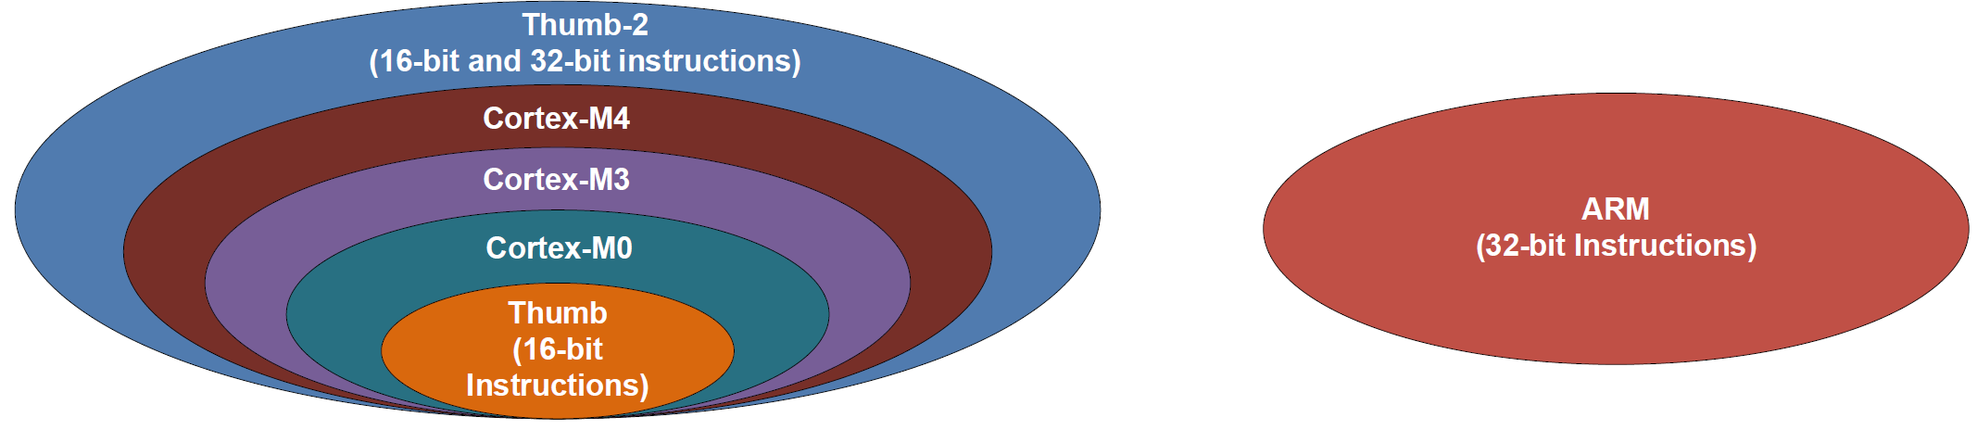
Instruction Sets
Instructions:
Encoded to binary machine code by assembler
Executed at runtime by hardware
Early 32-bit ARM vs Thumb/Thumb-2
Early ARM has larger power consumption and larger program size
16-bit Thumb, first used in ARM7TDMI processors in 1995
Thumb-2: a mix of 16-bit (high code density) and 32-bit (high performance) instructions
ARM Cortex-M:
Subset of Thumb-2

Slide 6
ARM Processors

Slide 7
Processor Registers
Fastest way to read and write
Registers are within the processor chip
Each register has 32 bits
ARM Cortex-M4 has
Register Bank: R0 – R15
R0-R12: 13 general-purpose registers
R13: Stack pointer (Shadow of MSP or PSP)
R14: Link register (LR)
R15: Program counter (PC)
Special registers
xPSR, BASEPRI, PRIMASK, etc
Register Bank
Special Registers

Slide 8
Processor Registers
Low Registers (R0 – R7)
Can be accessed by any instruction
High Register (R8 – R12)
Can only be accessed by some instructions
Stack Pointer (R13)
Cortex-M4 supports two stacks
Main SP (MSP) for privileged access (e.g. exception handler)
Process SP (PSP) for application access
Program Counter (R15)
Memory address of the current instruction
Register Bank
Special Registers

Slide 9
Processor Registers vs Peripheral Registers
ARM Cortex-M Core
ALU
Registers
Registers
Registers
Control Unit
GPIO B
GPIO A
UART1
SPI
ADC
Registers
Registers
Registers

Slide 10
Processor Registers vs Peripheral Registers
Processor can directly access processor registers
ADD r3,r1,r0 ; r3 = r1 + r0
Processor access peripheral registers via memory mapped I/O
Each peripheral register is assigned a fixed memory address at the chip design stage
Processor treats peripherals registers the same as data memory
Processor uses load/store instructions to read from/write to memory (to be covered in future lectures)

Slide 11
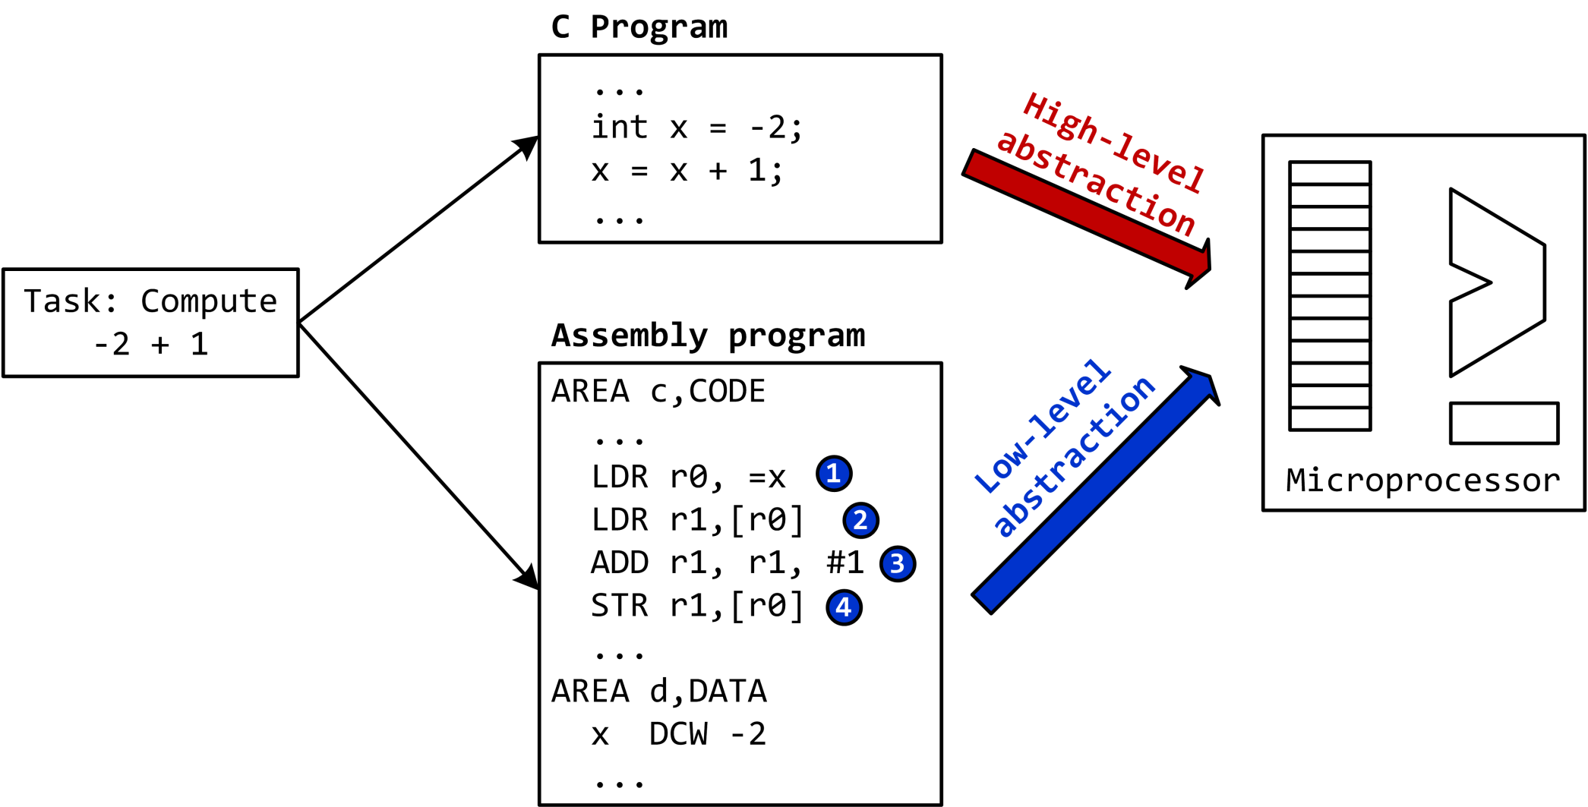
C vs Assembly

Slide 12
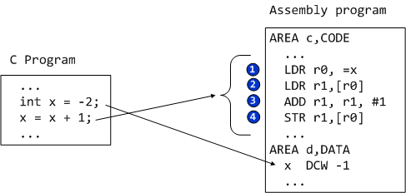
Load-Modify-Store
Translating C to assembly
Load values from memory into registers
Modify value by applying arithmetic operations
Store result from register to memory

Slide 13
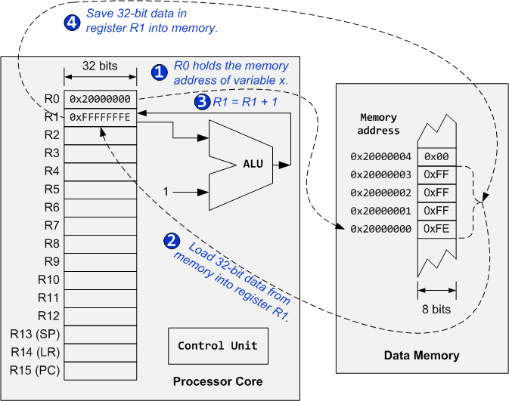
Load-Modify-Store

Slide 14
ARM Cortex-M4 Organization (STM32L4)
System-on-a-chip

Slide 15
Assembly Instructions
Arithmetic and logic
Add, Subtract, Multiply, Divide, Shift, Rotate
Data movement
Load, Store, Move
Compare and branch
Compare, Test, If-then, Branch, compare and branch on zero
Miscellaneous
Breakpoints, wait for events, interrupt enable/disable, data memory barrier, data synchronization barrier

Slide 16
Instruction Format: Labels
label mnemonic operand1, operand2, operand3 ; comments

Slide 17
Instruction Format: Labels
label mnemonic operand1, operand2, operand3 ; comments
Place marker, marking the memory address of the current instruction
Used by branch instructions to implement if-then or goto
Must be unique

Slide 18
Instruction Format: Mnemonic
label mnemonic operand1, operand2, operand3 ; comments
The name of the instruction
Operation to be performed by processor core

Slide 19
Instruction Format: Operands
label mnemonic operand1, operand2, operand3 ; comments
Operands
Registers
Constants (called immediate values)
Number of operands varies
No operands: DSB
One operand: BX LR
Two operands: CMP R1, R2
Three operands: ADD R1, R2, R3
Four operands: MLA R1, R2, R3, R4
Normally
operand1 is the destination register, and operand2 and operand3 are source operands.
operand2 is usually a register, and the first source operand
operand3 may be a register, an immediate number, a register shifted to a constant number of bits, or a register plus an offset (used for memory access).

Slide 20
Instruction Format: Comments
label mnemonic operand1, operand2, operand3 ; comments
Everything after the semicolon (;) is a comment
Explain programmers’ intentions or assumptions

Slide 21
ARM Instruction Format
label mnemonic operand1, operand2, operand3 ; comments
target ADD r0, r2, r3 ; r0 = r2 + r3
label
mnemonic
destination operand
1st source operand
2nd source operand
comment

Slide 22
ARM Instruction Format
label mnemonic operand1, operand2, operand3 ; comments
Examples: Variants of the ADD instruction
ADD r1, r2, r3 ; r1 = r2 + r3
ADD r1, r3 ; r1 = r1 + r3
ADD r1, r2, #4 ; r1 = r2 + 4
ADD r1, #15 ; r1 = r1 + 15

Slide 23
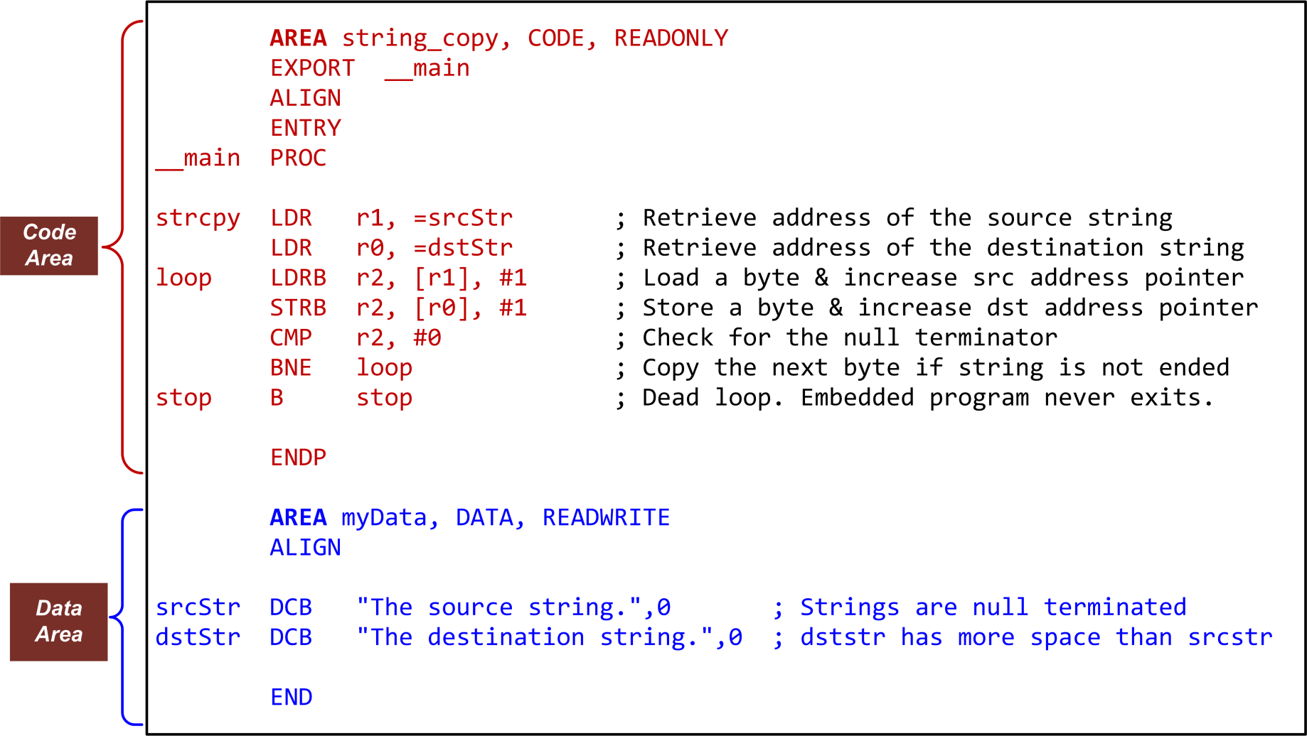
Example Assembly Program: Copying a String

Slide 24
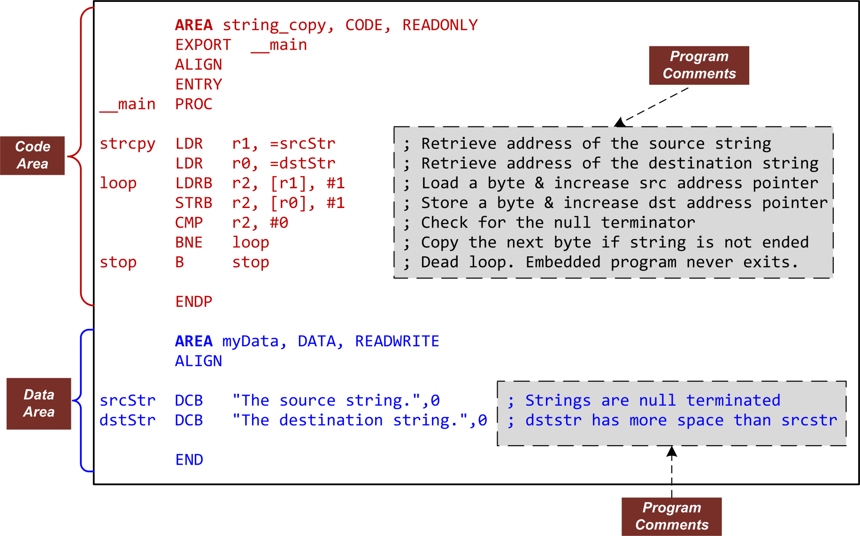
Example Assembly Program: Copying a String

Slide 25
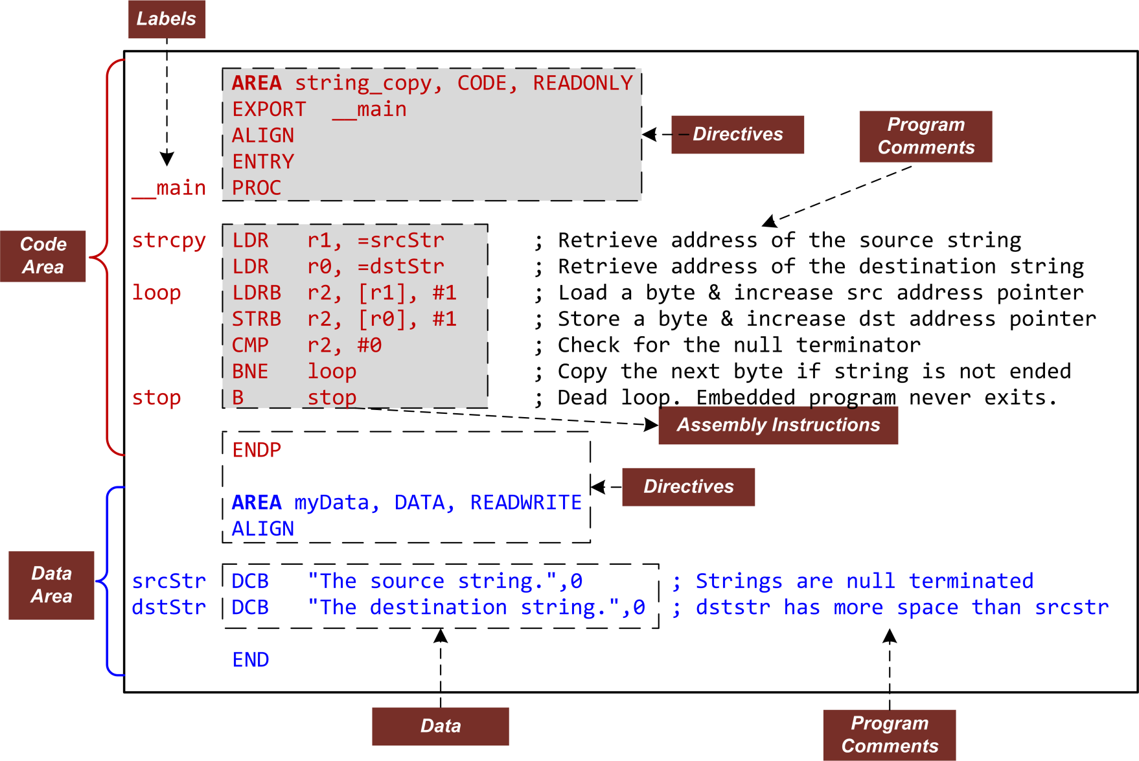
Example Assembly Program: Copying a String

Slide 26
Logic View of Memory
By grouping bits together we can store more values
8 bits = 1 byte
16 bits = 2 bytes = 1 halfword
32 bits = 4 bytes = 1 word
From software perspective, memory is an addressable array of bytes.
The byte stored at the memory address 0x20000004 is 0b10000100
A word can only be stored at an address that‘s divisible by 4 （Word-address mod 4 = 0, binary address ends with 00）
Memory address of a word is the lowest address of all 4 bytes in that word.
A halfword can only be stored at an address that‘s divisible by 2 （Halfword-address mod 2 = 0, binary address ends with 0）
Memory address of a halfword is the lowest address of all 2 bytes in that word.
8 bits
High Address
0x20000007
01110010
0x20000006
00100101
0x20000005
11100010
0x20000004
10000100
0x20000003
01100001
0x20000002
10001111
0x20000001
00010010
0x20000000
10010100
0b10000100
0x84
132
Low Address
Binary
Hexadecimal
Decimal
Notes:
0b10000100 0x84 132

Slide 27
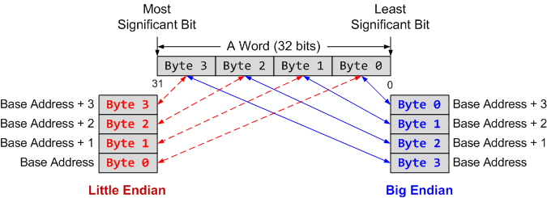
Memory Byte Ordering
Two possible byte orderings:
Little-endian: the LSB (Least Significant Byte) is stored at the lowest address.
Big-endian: the LSB (Least Significant Byte) is stored at the highest address.
Intel processors use Little-Endian; ARM processors can be configured as either Little- or Big-endian; STM32 microcontrollers based on ARM Cortex-M3 use little-endian
0x103
D4
LSB
0x102
C3
Big-Endian
0x101
B2
0x100
A1
MSB
0x103
A1
MSB
0x102
B2
Little-Endian
0x101
C3
0x100
D4
LSB
Example: 4-byte data 0xA1B2C3D4 at memory address 0x100 (Memory address is Byte address, not bit address)
Notes:
Below are examples of Little Endian ordering (A 32-bit memory range can contain one 32-bit word, or two 16-bit half-words, or four 8-bit Bytes)

Slide 29
Little-Endian
LSB is at lower address
Memory Value
Offset (LSB) (MSB)
====== ===========
uint8_t a = 1; 0x0000 01 02 FF 00
uint8_t b = 2;
uint16_t c = 255; // 0x00FF
uint32_t d = 0x12345678; 0x0004 78 56 34 12
Big-Endian
MSB is at lower address
Memory Value
Offset (LSB) (MSB)
====== ===========
uint8_t a = 1; 0x0000 01 02 00 FF
uint8_t b = 2;
uint16_t c = 255; // 0x00FF
uint32_t d = 0x12345678; 0x0004 12 34 56 78

Slide 30
Data Alignment
Assume a byte-addressable memory with a data bus that is 32 bits (4 bytes) wide
Consider 16 bytes of memory (addresses 0 to 15) arranged as four 32-bit words (4 bytes each)
Well-aligned: each word begins on a mod-4 address, which can be read in a single memory cycle
Ill-aligned: a word begins on address 6, not a mod-4 address, which can be read in 2 memory cycles
The first read cycle would retrieve 4 bytes from addresses 4 through 7; of these, the bytes from addresses 4 and 5
are discarded, and those from addresses 6 and 7 are moved to the far right;
The second read cycle retrieves 4 bytes from addresses 8 through 11; the bytes from addresses 10 and 11 are discarded, and those from addresses 8 and 9 are moved to the far left;
Finally, the two halves are combined to form the desired 32-bit operand:

